Slide 1

Anita & Caitlyn’s Car Rental
ITEC 325
Nov,16,2022

Slide 2
Define
The purpose was to create a car rental website where we serve people who require a temporary vehicle at low costs, such as those who do not own cars, travelers who are out of town, or owners of damaged or destroyed vehicles awaiting repair or insurance compensation. It was extremely important for us to make sure we built all these features within the deadline. Ensuring the website is responsive to all browsers and software was essential to us, so we spent some time on CMS, heuristic designs, responsive websites, etc.

Slide 3
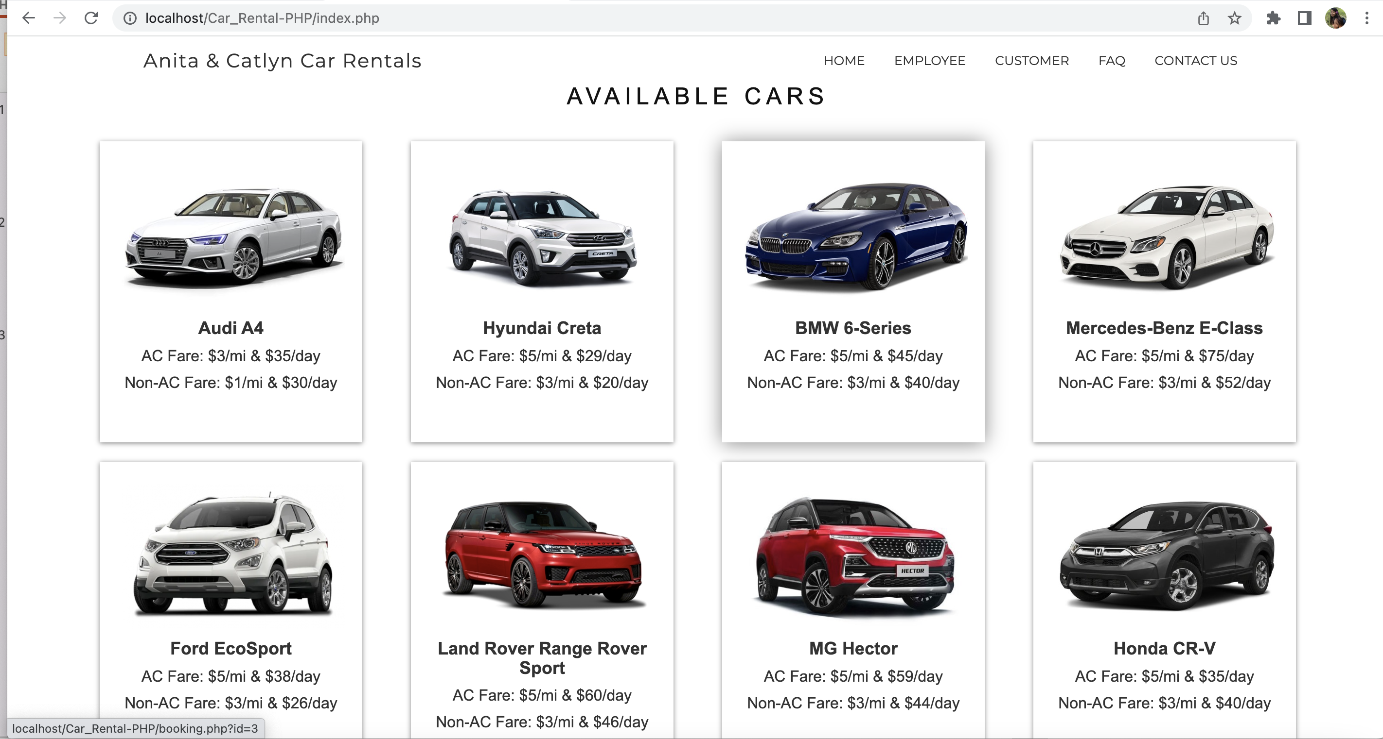
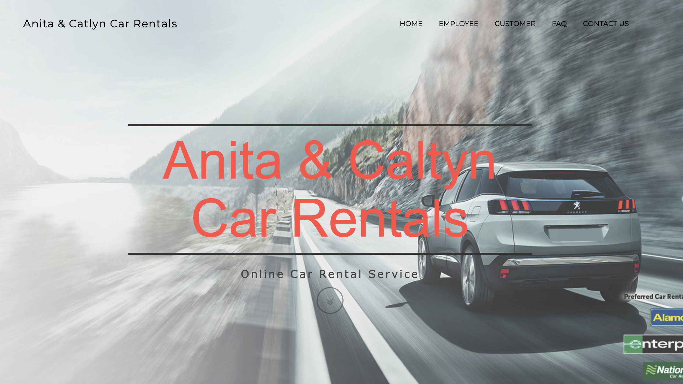
Home Page
Employees and customers can signup and log in to this main page.
It displays all the available cars on the home page from the database.
Add to the carts
Contact us
FAQ

Slide 4
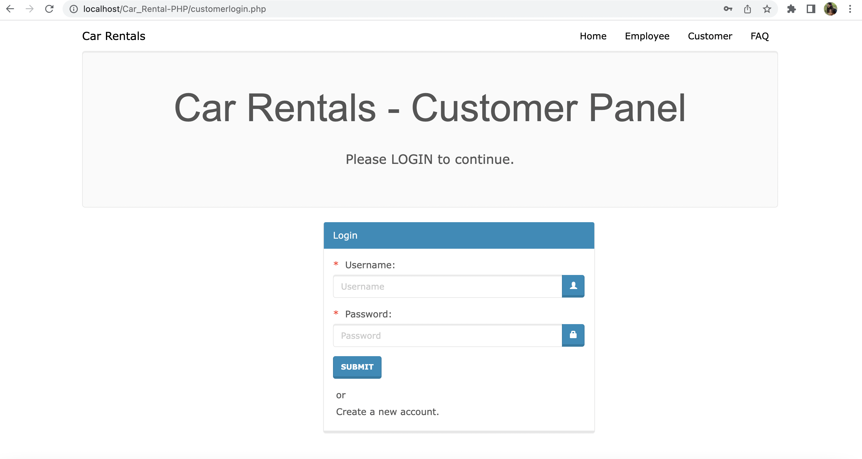
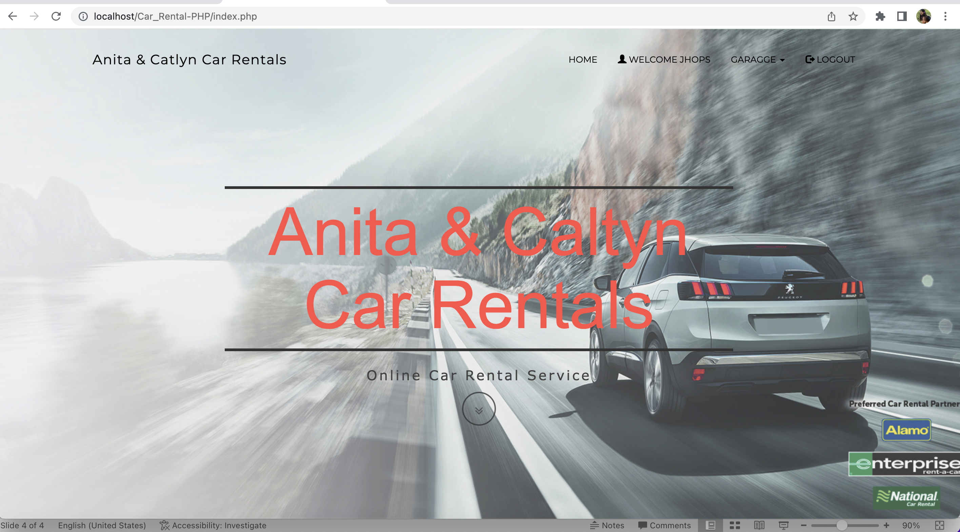
Customer login/signup

Slide 5
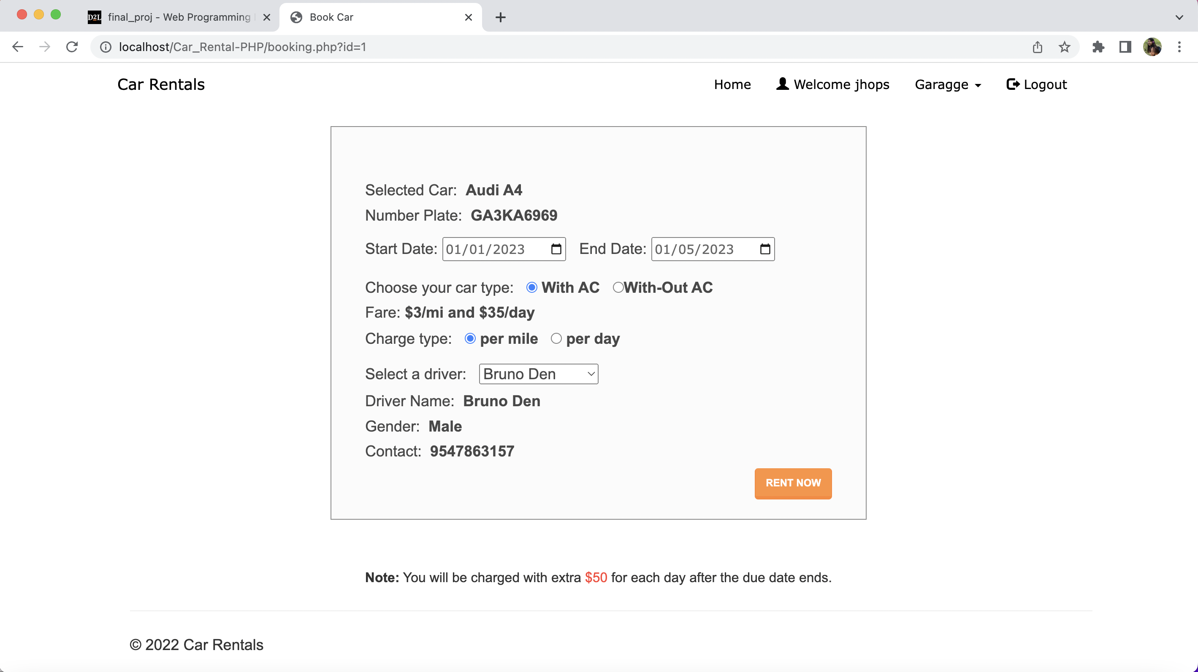
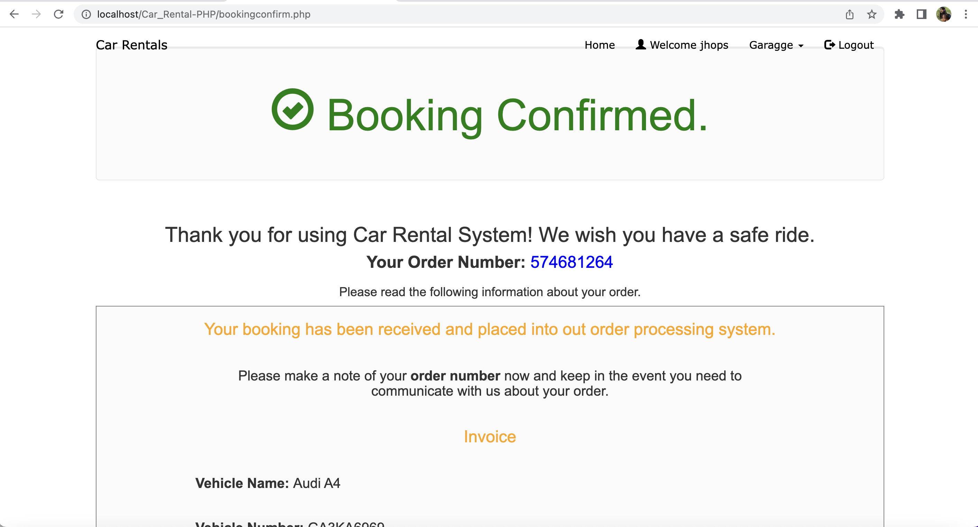
Booking from customer page

Slide 6
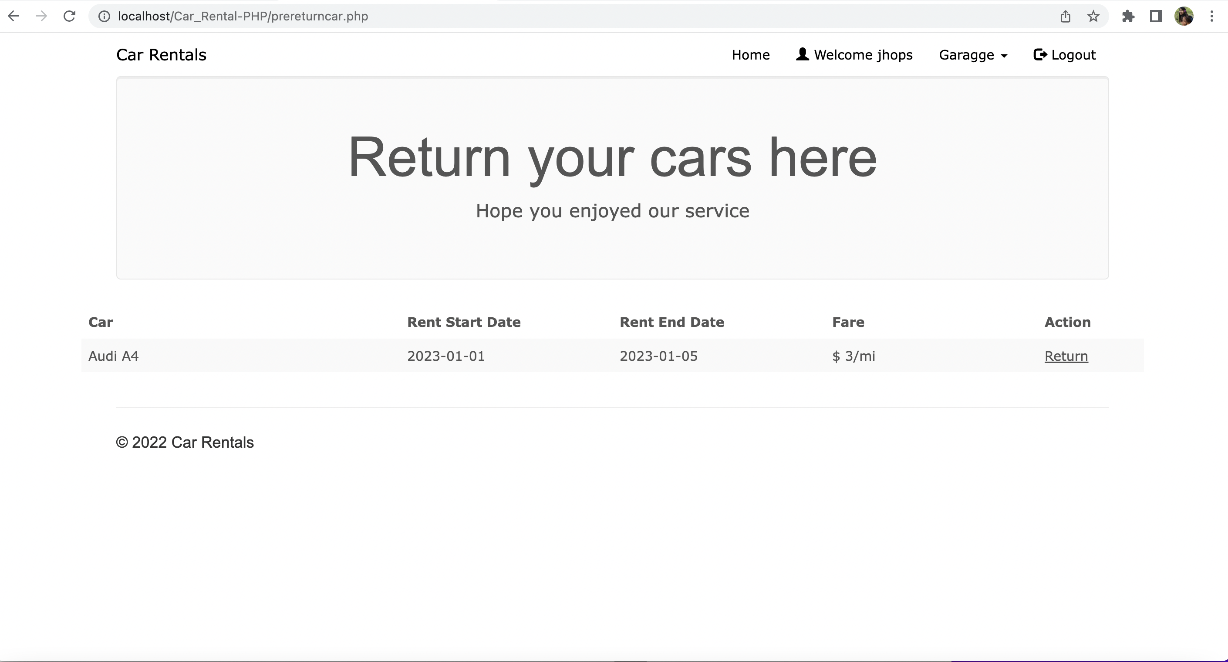
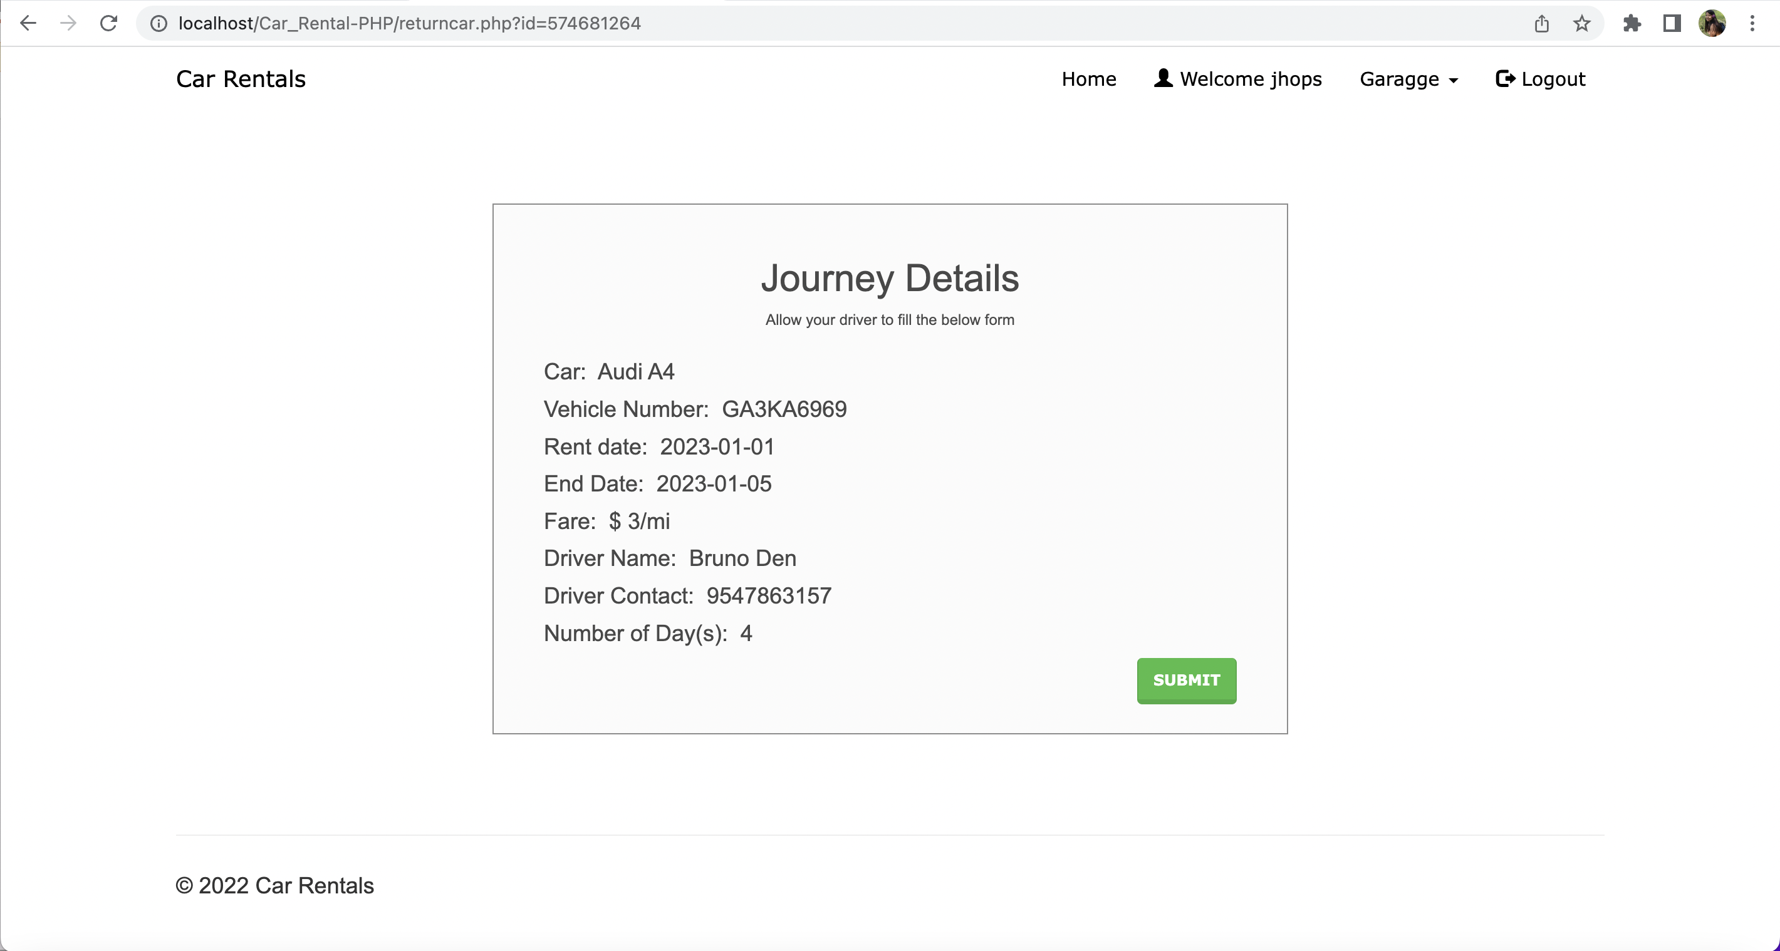
Returning car

Slide 7
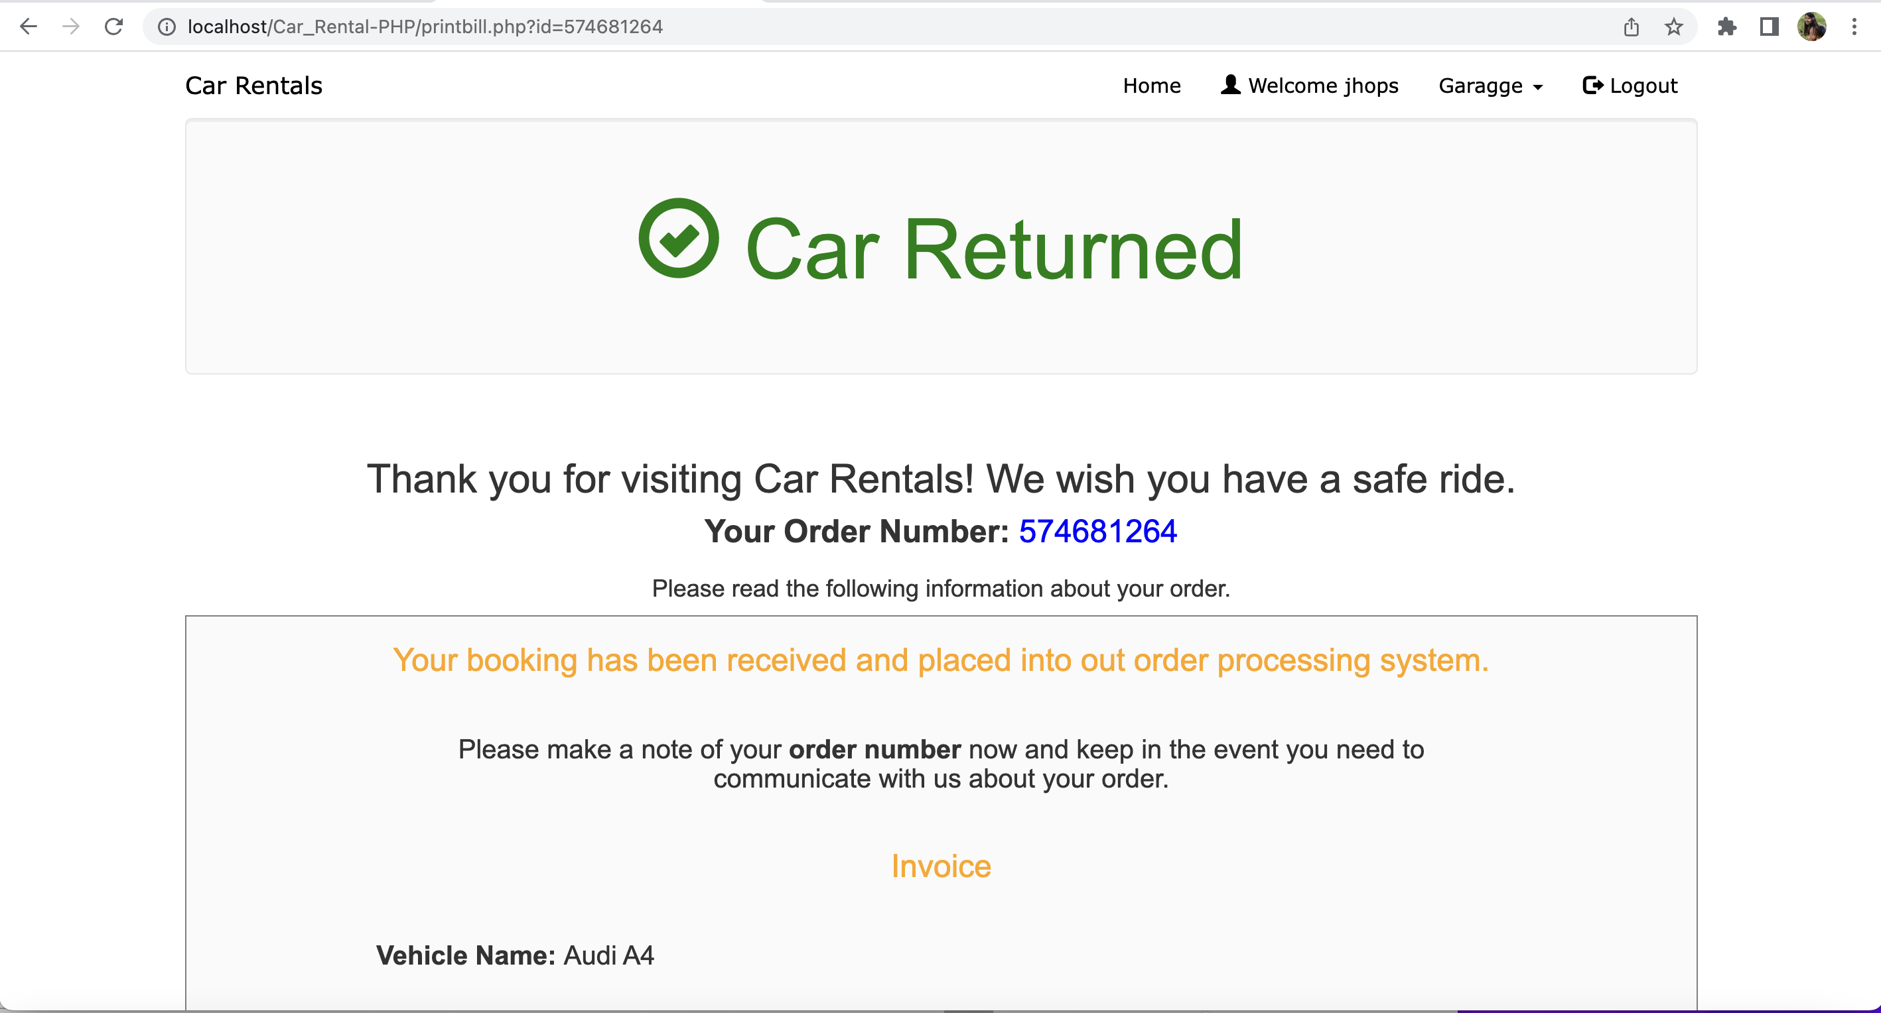
Returned

Slide 8
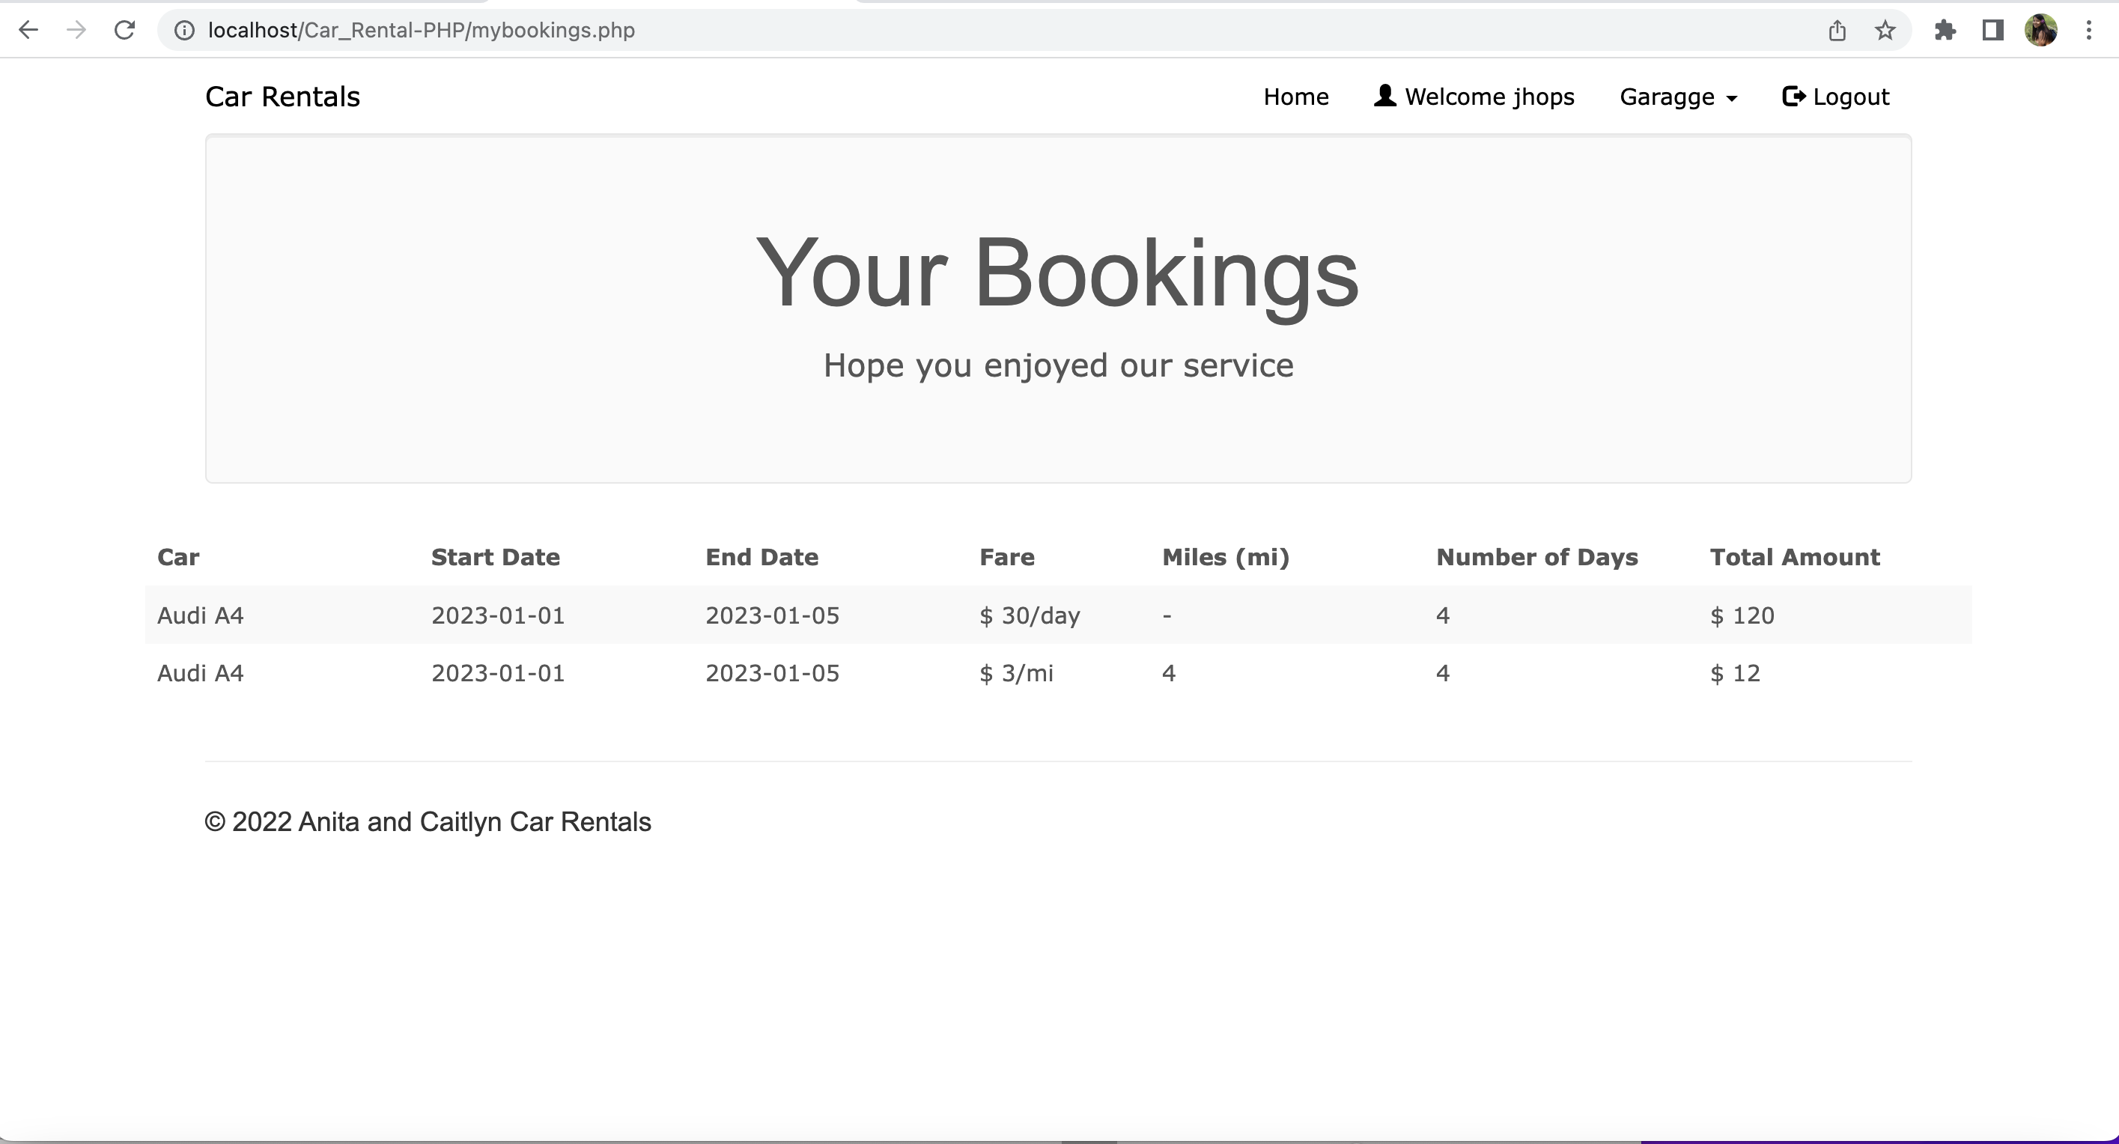
Bookings history

Slide 9
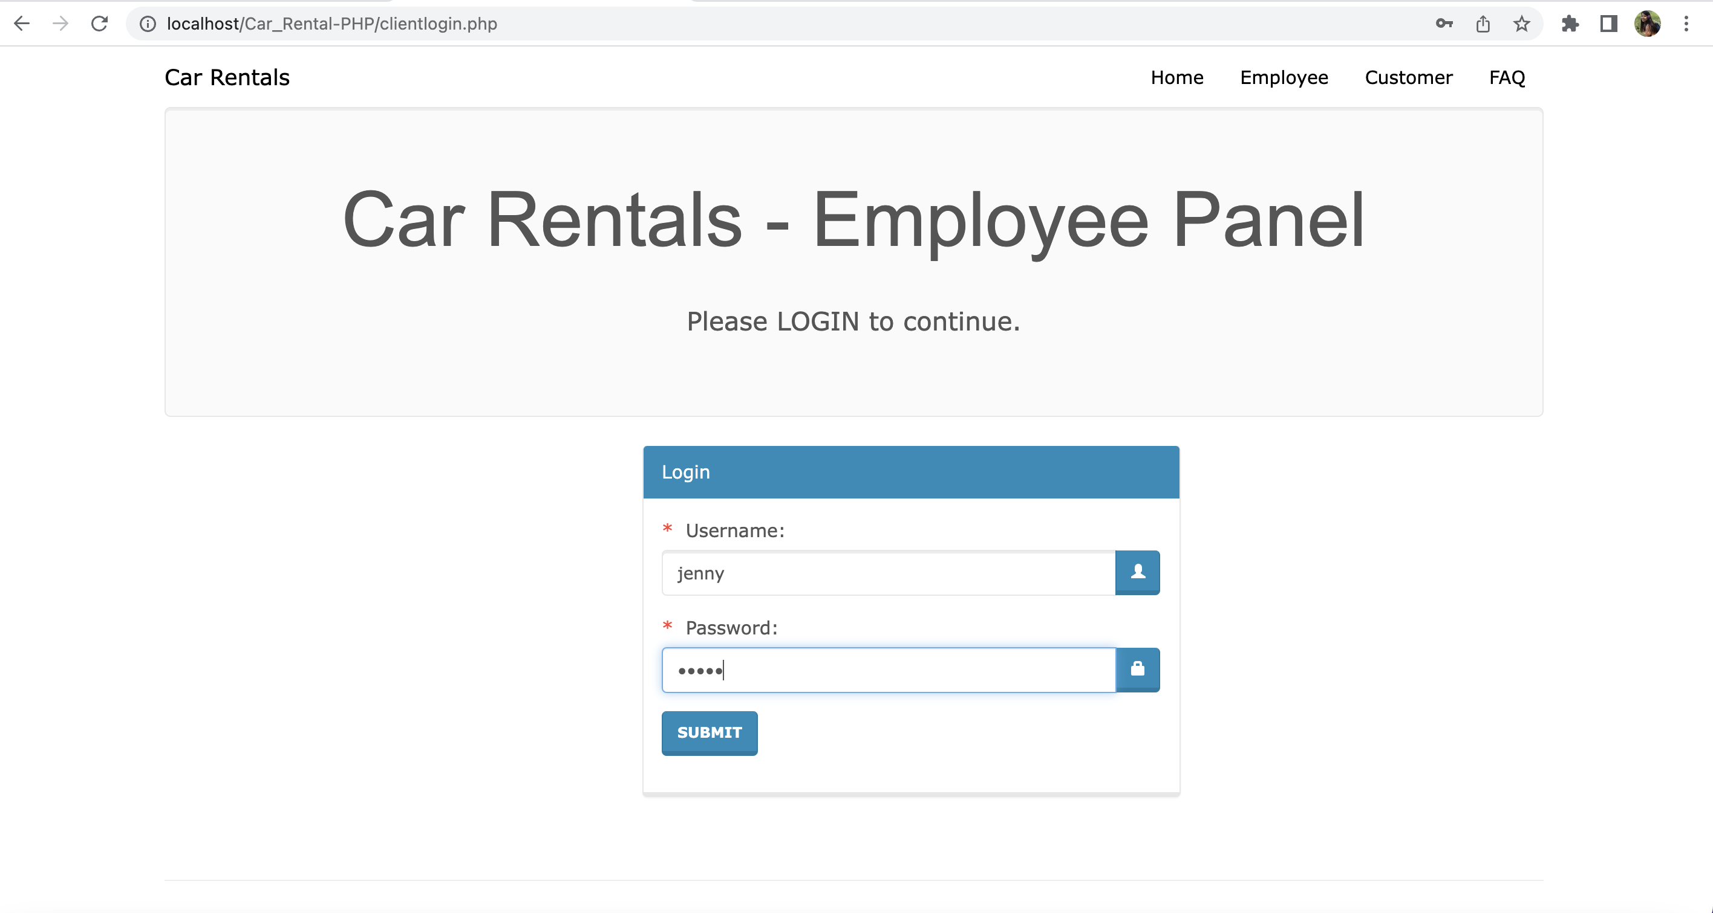
Employee Login

Slide 10
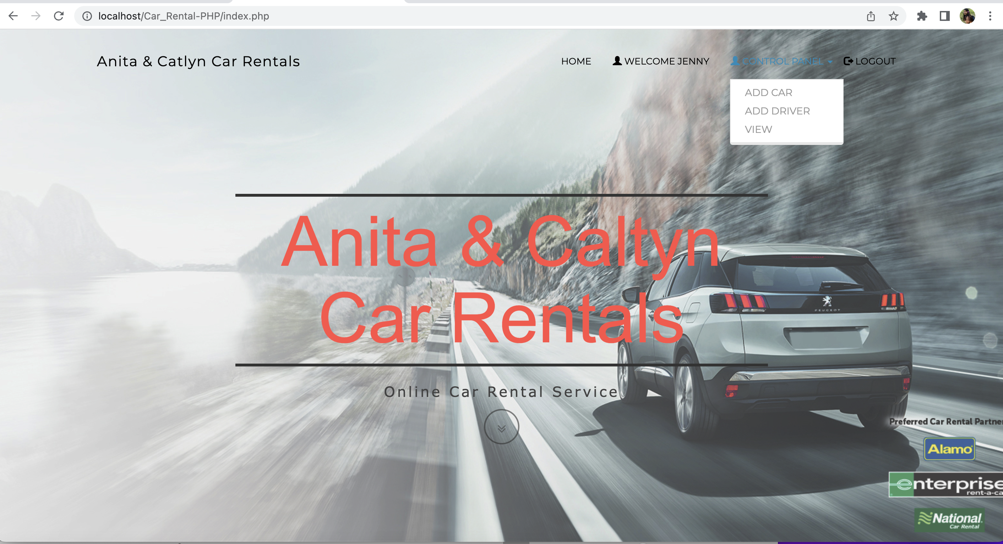
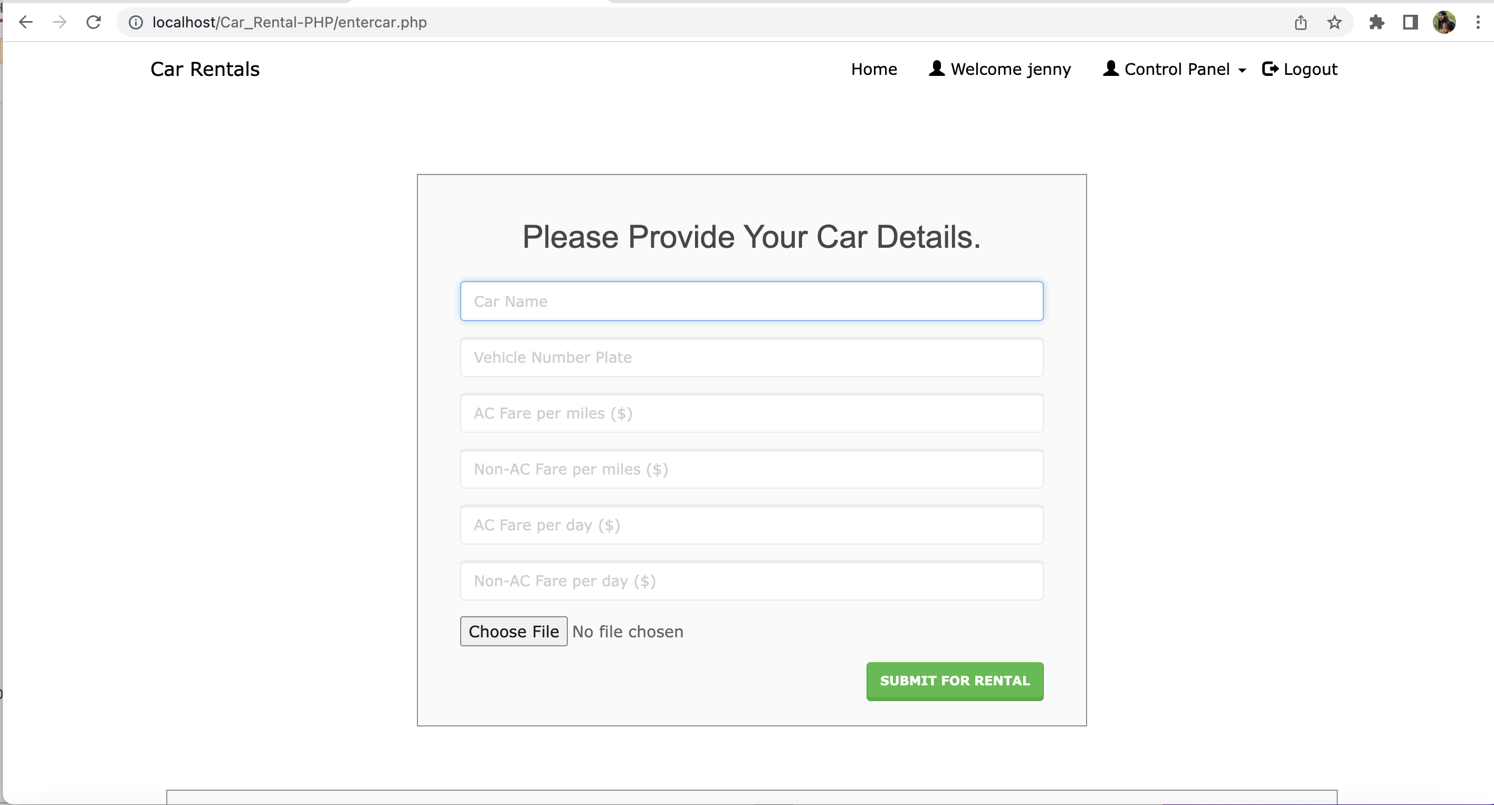
Employee Features

Slide 11
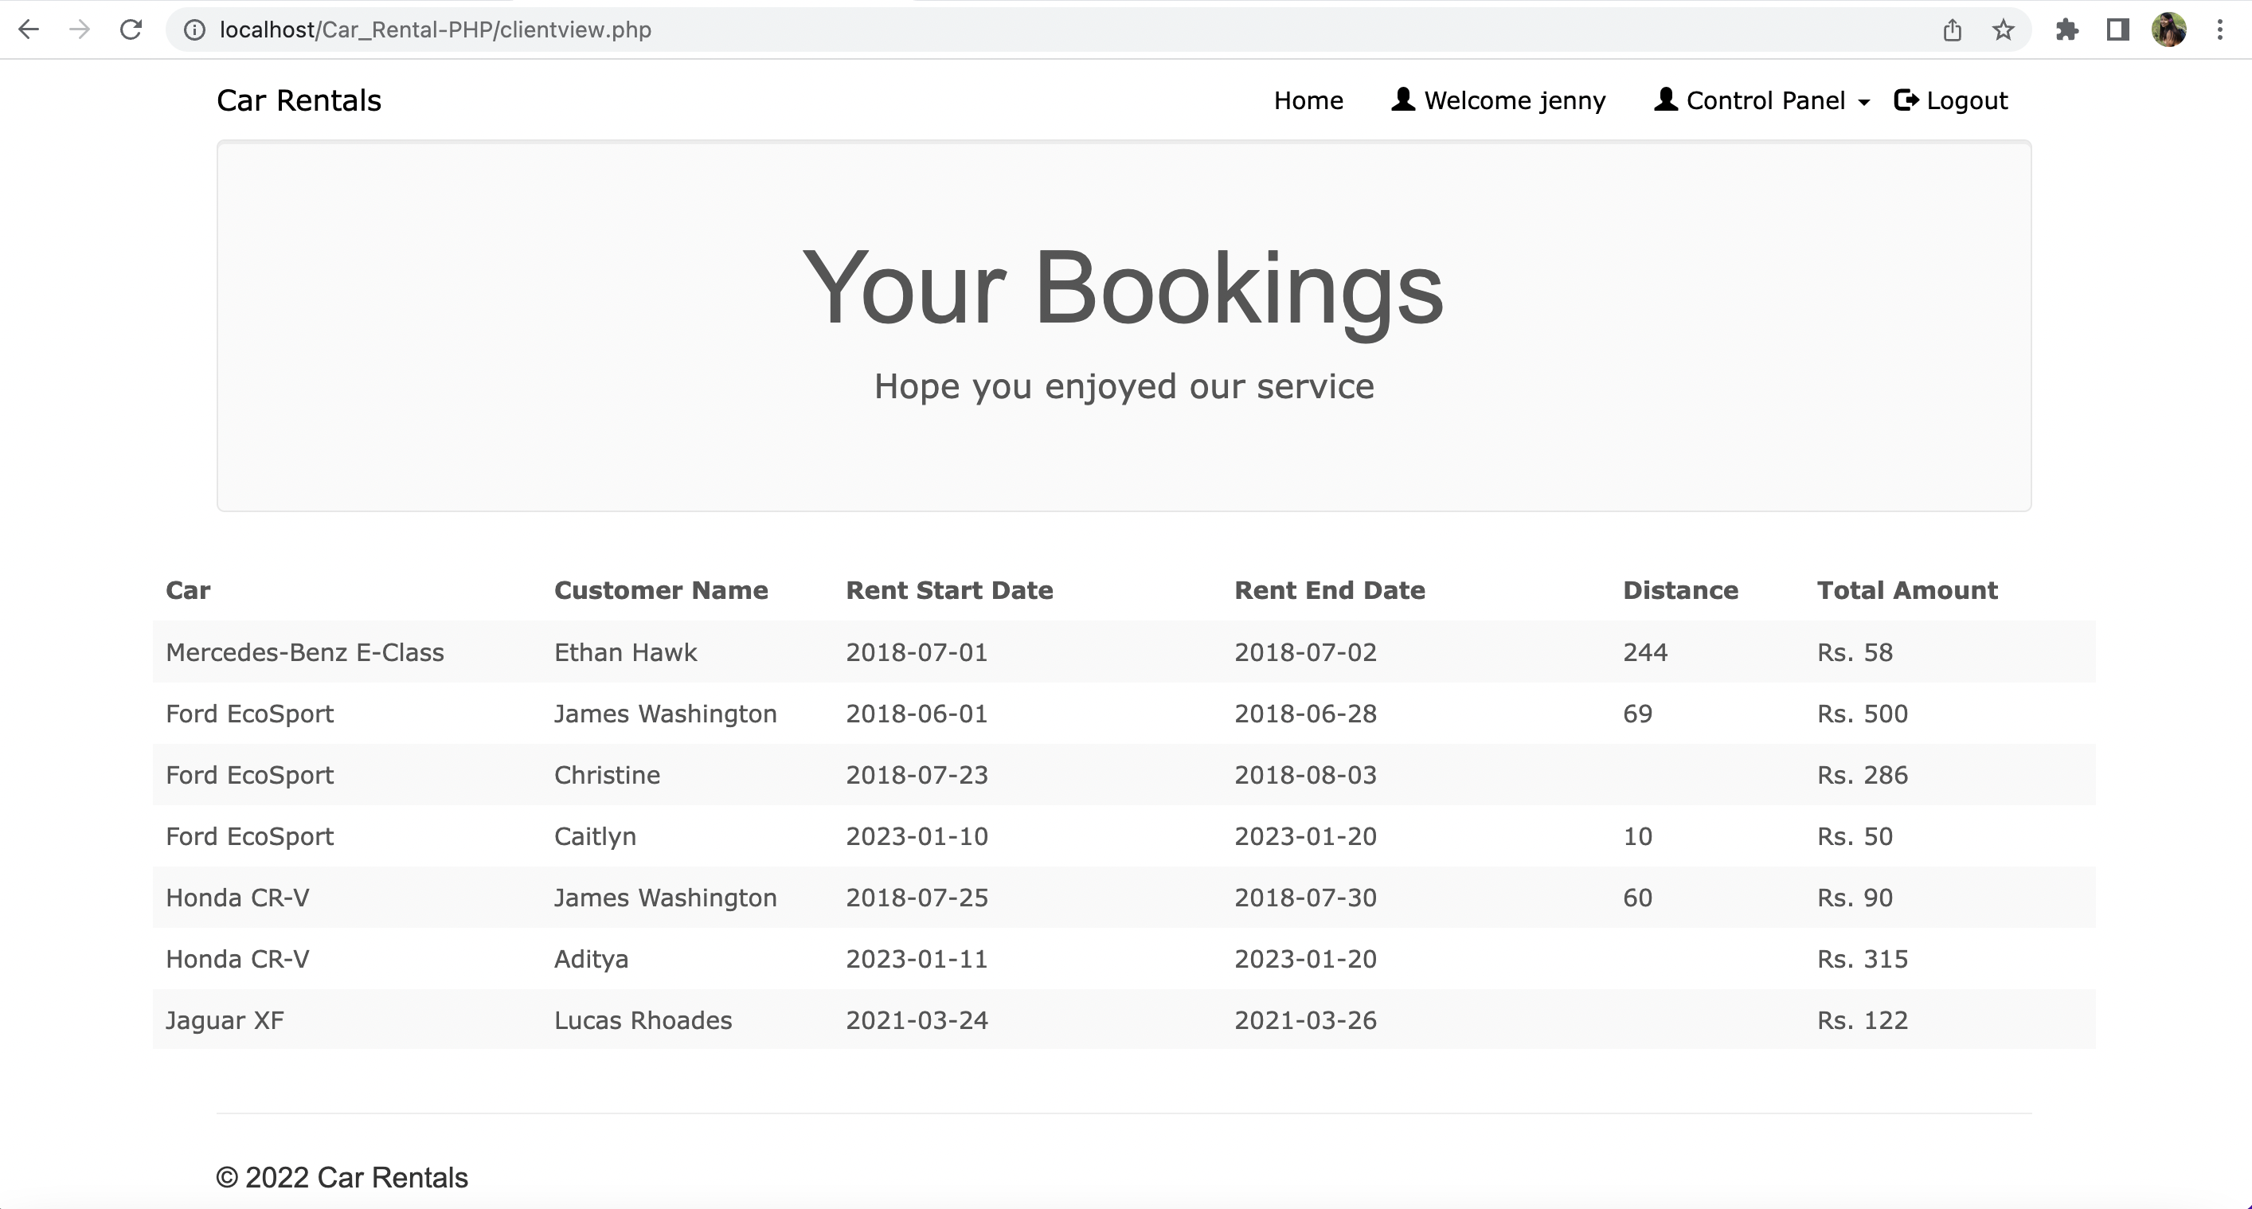
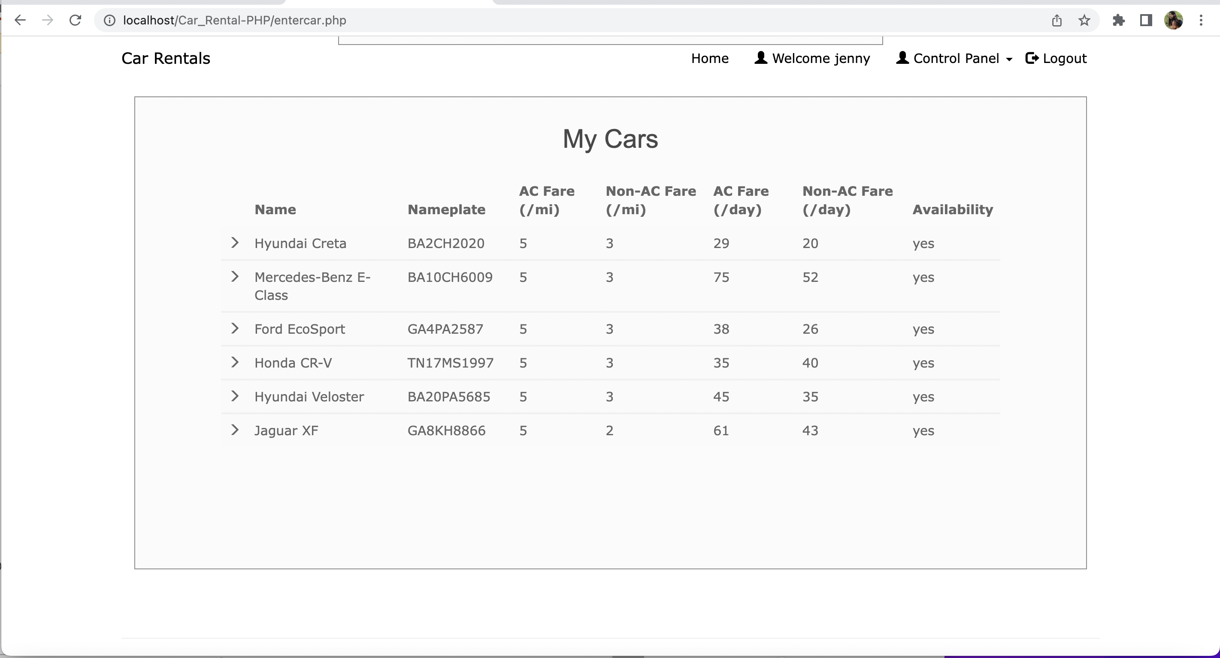
Continue

Slide 12
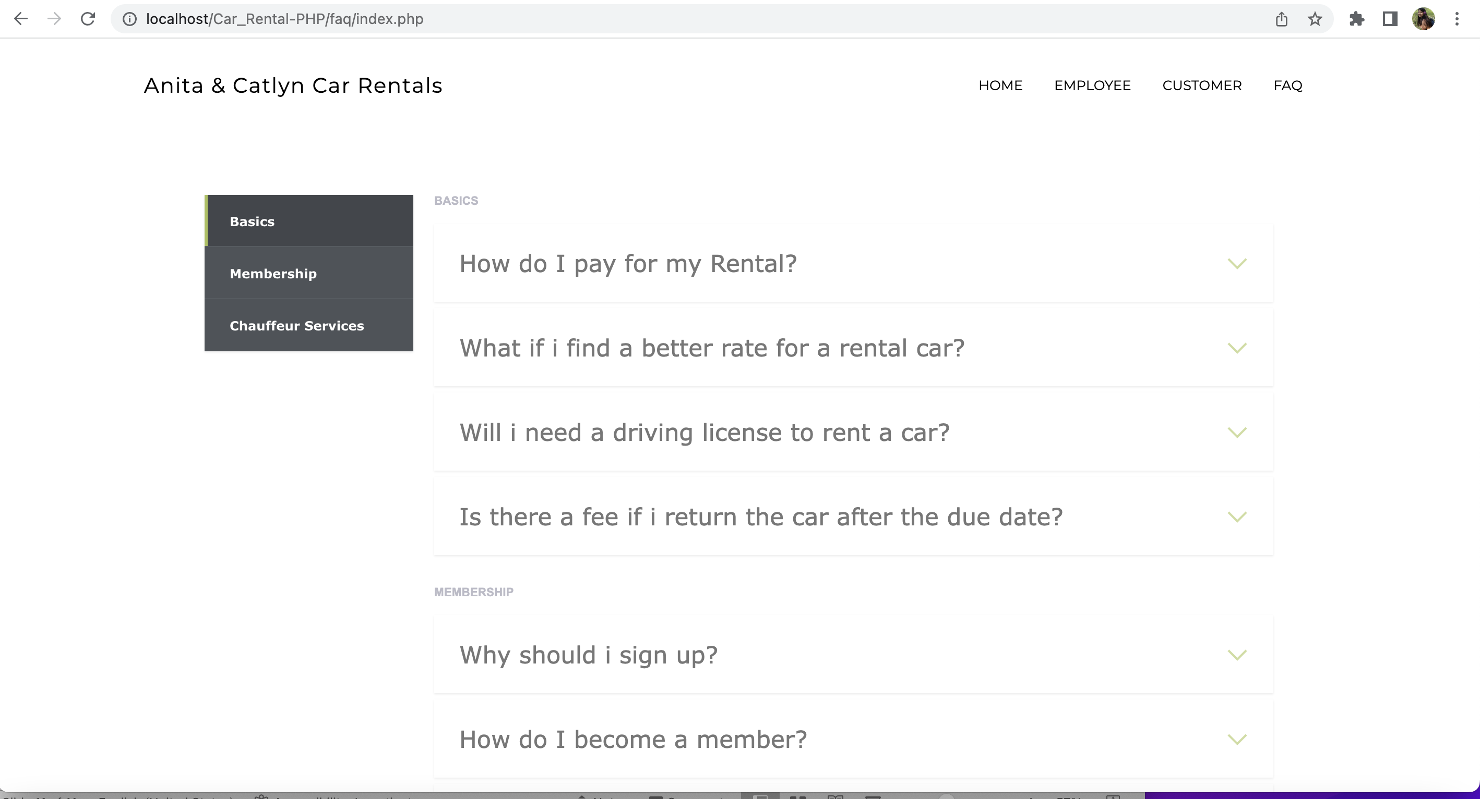
FAQ

Slide 13
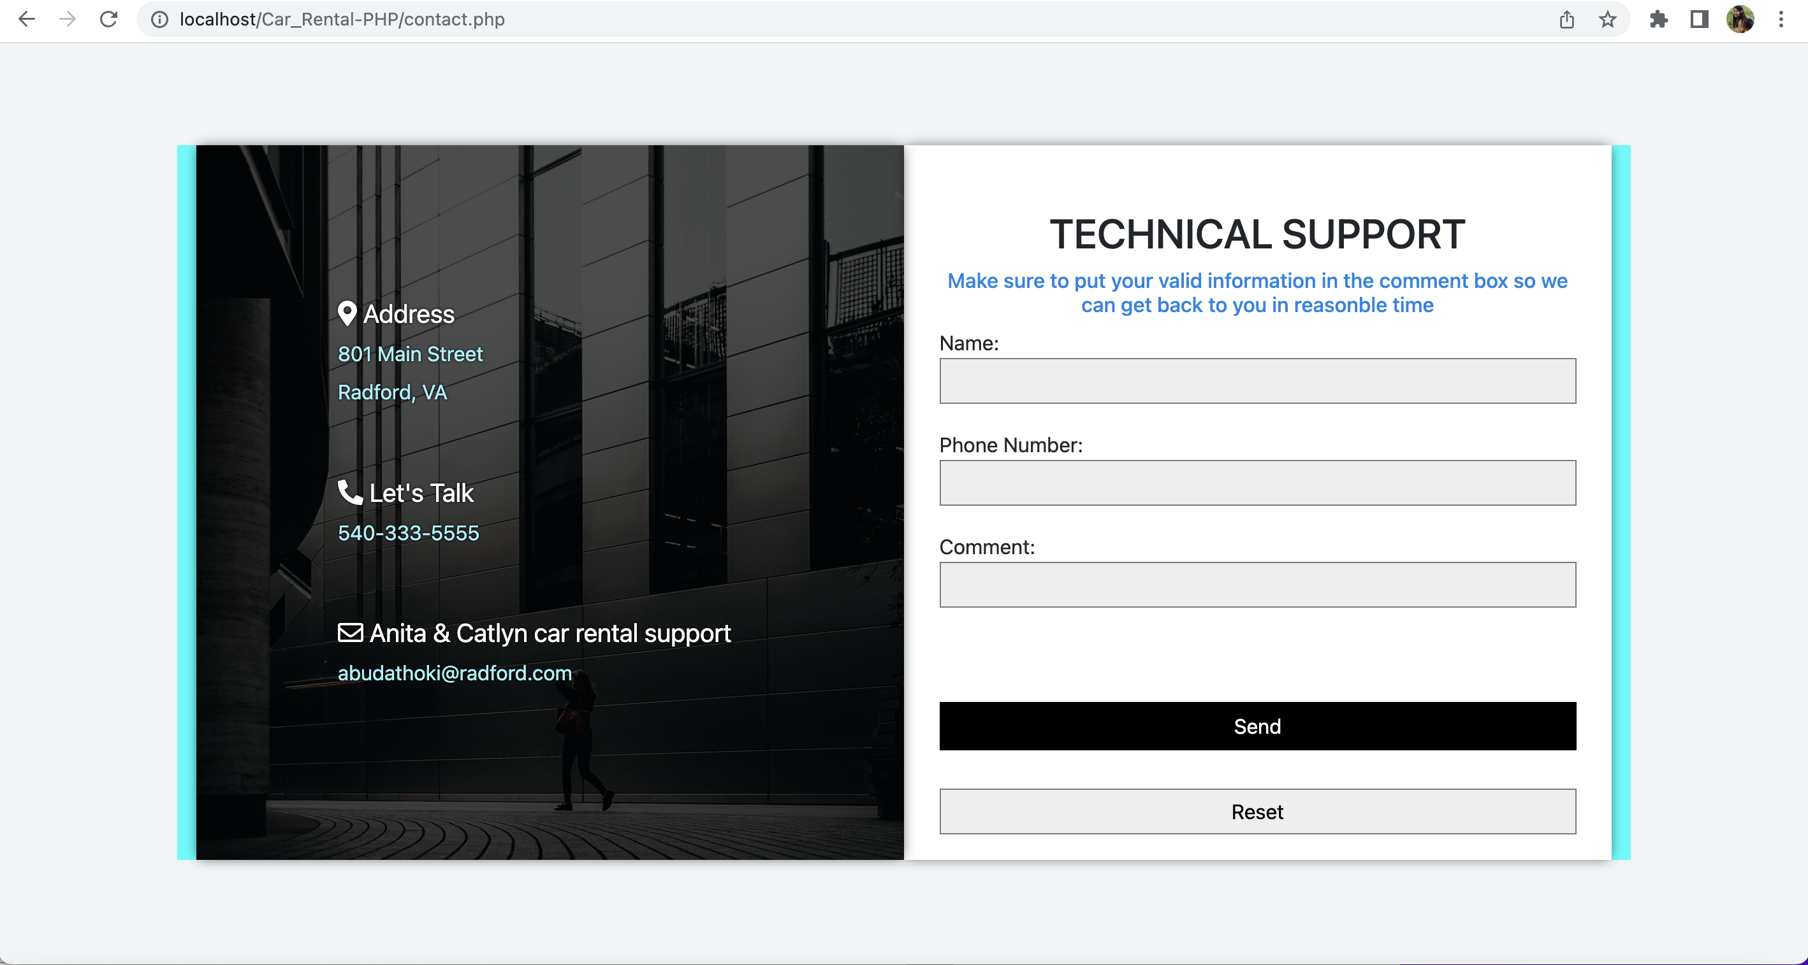
Contact us

